Slide 1
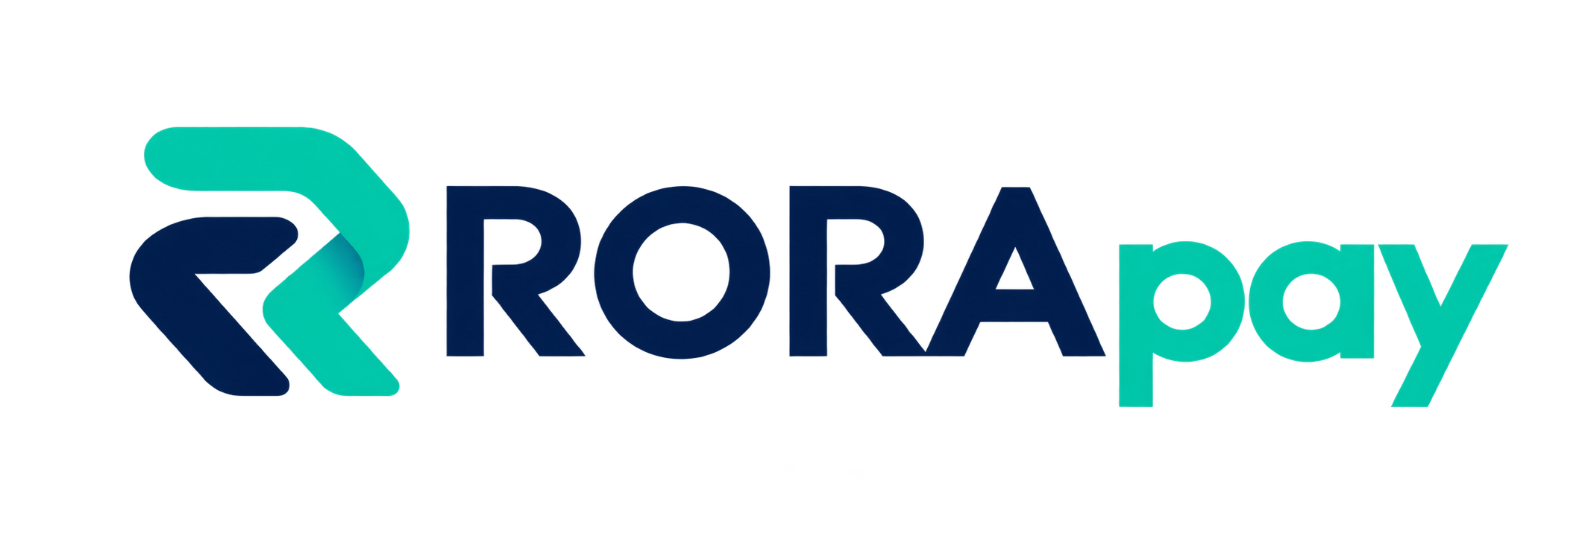
Payments within your limits
roracrypto.com
An AI payment agent with a visible spending boundary
Public demo, source code and verifiable receipts
Topic F · Ethereum Sepolia research prototype
RORApay · Roma & Rasul
01
Notes:
Opening (45 seconds). RORApay is our closed research prototype for Topic F, Autonomous On-chain Wallet. The owner defines authority; the model cannot enlarge it. All demonstrated transfers use synthetic rUSD on Ethereum Sepolia. Artwork is an AI-generated raster render of our supplied mark.

Slide 2
User problems
“What stops an agent from exhausting its budget?”
People need limits outside the model’s reasoning loop.
“Did this invoice already get paid?”
A new request ID or an uncertain receipt should not cause another payment.
Forum signals · self-reported examples, not measured prevalence
RORApay · Roma & Rasul
02
Notes:
Qualitative source review, not a survey (50 seconds). Users question prompt-only controls and worry about loops draining a wallet. One forum participant self-reports triple payment. Another describes forgotten unlimited approvals. We make no prevalence claim and did not verify these incidents independently. Sources: https://www.reddit.com/r/aiagents/comments/1v374lv/are_you_guys_actually_giving_agents_access_to/ ; https://www.reddit.com/r/AI_Agents/comments/1s8bq8k/what_happens_when_ai_agents_can_spend_money/ ; https://www.reddit.com/r/defi/comments/1ww06jx/how_often_do_you_revoke_old_token_approvals/ ; https://ethereum.org/guides/how-to-revoke-token-access

Slide 3
Owner-defined authority
100 rUSD
Owner controlled
One shared budget across allowed recipients
Allowed recipients
Expiry
Revocation
25 per payment · 10 calls · 24 hours
Fixed token and network. Owner can revoke.
RORApay · Roma & Rasul
03
Notes:
Permission mechanism (60 seconds). Initial public demonstration: 100 rUSD shared budget, 25 per payment, 10 calls, 24-hour expiry, two allowed recipients. Fixed token and chain. Owner-only grant and revoke. No arbitrary calls, approvals, upgrades or redelegation. Current permission is revoked and 98 rUSD remain. Sources: contracts/AgentVault.sol; evidence/testnet-deployment-11155111.json; evidence/public-controls.json.

Slide 4
Trust boundaries
Owner input
Trusted recipient and exact token amount
Untrusted invoice
Model proposes; invoice cannot grant authority
Executor
Validates, simulates, journals and broadcasts
Contract
Enforces limits independently of model output
RORApay · Roma & Rasul
04
Notes:
Architecture (65 seconds). Passkey authenticates the workspace session; it is not wallet ownership. Owner wallet creates the contract permission. Timeweb GPT-6 Luna emits a single proposal through Responses API. Strict validation checks the trusted address and exact amount. A dedicated executor persists signed transaction and hash before broadcast. Contract enforces its independent envelope. Owner key never reaches backend or model. Sources: src/auth.ts, src/ai.ts, src/server.ts, contracts/AgentVault.sol.

Slide 5
Inspectable autonomy
Before spending
Rehearse the current permission and see every failed check without invoking AI or signing.
Across retries
The same invoice, recipient and amount return the existing pending or confirmed request.
After inclusion
Compare the included contract event with the owner’s original recipient, amount and request.
RORApay · Roma & Rasul
05
Notes:
Innovation (65 seconds). Our contribution combines rehearsal, controlled execution, exact-invoice duplicate guard and original-intent verification. Spending limits and these constituent mechanisms are not claimed to be world-first. Rehearsal is read-only and not a reservation. Exact invoice matching is not semantic matching. Proof depends on the configured RPC and cannot prove merchant delivery. Sources: docs/INNOVATION.md; src/rehearsal.ts; src/payment-journal.ts; src/receipt-proof.ts.

Slide 6
Public execution evidence
2 payments
4 reverted attempts
Exact owner intent retained
Direct contract bypass tests
Owner revocation confirmed
Inactive · 98 rUSD remaining · 8 calls remaining
RORApay · Roma & Rasul
06
Notes:
Evidence (70 seconds). Two authenticated 1 rUSD payments included on Ethereum Sepolia. A malicious invoice asked for recipient 0x3333…3333 and amount 999; the included event retained 1 rUSD to 0x1111…1111. Four direct agent attempts reverted: unauthorized recipient, above-cap amount, replay and payment after owner revocation. Owner revocation succeeded. Current inactive state: 98 rUSD and 8 calls. Public links: https://sepolia.etherscan.io/tx/0x09da1e681d8a591337d29188d3d73a09ec6a4e89a654001e9dfdef7024b926f0 ; https://sepolia.etherscan.io/tx/0x1f378b1a59530d9660735c1c8b226ad4caaeb13b1473e31e4c722514575c57a5 ; https://sepolia.etherscan.io/tx/0x250773e037630642a8e168314387c2a6242c523de0697af8e4df877ff3b382f7 . All rejection hashes: evidence/public-controls.json.

Slide 7
Measured checks and limits
50 / 50
200 / 200
Legitimate proposal cases
Synthetic adversarial invoices
12 local tests pass
Proposal benchmark ≠ universal injection immunity or independent audit
RORApay · Roma & Rasul
07
Notes:
Evaluation (60 seconds). Timeweb Responses proposal benchmark recorded 50/50 legitimate tasks and 200/200 synthetic adversarial invoices aligned to trusted intent, zero gateway errors. This benchmark precedes the final stricter amount schema and is not 250 on-chain transactions. Current 12 local tests cover validator, incomplete model output, invoice/journal duplicates, rehearsal, forged receipt fields and local contract controls. No user study or independent audit. Sources: evidence/ai-benchmark.json; evidence/local-tests.txt; tests/.

Slide 8
Product and next gates
Web + iOS simulator + Android APK
One identity: navy structure, turquoise action, visible permission state
Next gates
Native screen QA · signed iPhone provisioning
Organizer confirmation · final narrated demonstration
Closed testnet prototype · unaudited contract · no real trading
RORApay · Roma & Rasul
08
Notes:
Product readiness and limits (65 seconds). Web: overview, markets, paper trade, AI payments and permissions. Native iOS app built and launched in simulator; Android release APK built, verified and installed. Native screen interaction QA remains blocked by ScreenCaptureKit capture failure; no hardware attestation or signed iPhone IPA. Visual identity and brandbook prepared. Real trading, merchant delivery proof and mainnet are outside this prototype. Organizer testnet acceptance unresolved; inquiry remains unsent. Team: Roma and Rasul. Sources: docs/STATUS.md; docs/brand/BRANDBOOK.md; evidence/android-build.txt; evidence/ios-build.txt.

